Slide 1
AI-Powered Data Migration &
Modernization Agent
DXC Technology
August 2026

Slide 2
Agenda
01 Overview — AI Migration Agent capabilities & tech stack
02 Business Challenges — Risky, Slow and Expensive
03 Architecture — Multi-agent system design & workflow
04 Pre-Migration (Phases 1–4) — Connect, Discover, Analyze, Map
05 Migration (Phases 5–7) — Approve, Generate DDL, Execute
06 Post-Migration (Phases 8–9) — Validate & Report
07 Business Benefits — Faster, Zero data loss, Real-time drift detection, Full audit trail
06 Demo & Q&A — Live demonstration

Slide 3
Overview
AI Data Migration Agent
The AI Data Migration Agent is an intelligent, end-to-end database migration solution that automates the complete migration lifecycle from Oracle to Azure SQL. Built by the Technology, it leverages AI (Azure OpenAI GPT-4omini) orchestrated through a LangGraph workflow to eliminate manual effort, reduce human error, and accelerate migration timelines.
End-to-end migration: Oracle → Azure SQL
• AI-powered datatype analysis with confidence scores
• Automated DDL generation for Azure SQL
• Human-in-the-loop approval gates
• 9-phase LangGraph orchestration
• Real-time Flask dashboard
• AI-generated executive reports (PDF)
Tech Stack:
Azure OpenAI (GPT-4omini) + LLM + LangGraph + LangChain
Python, Flask, Streamlit, Azure devtunnel,
pyodbc, oracledb, SQLAlchemy

Slide 4
1
Business Impact
500+ database objects requiring manual analysis and mapping
Weeks of DBA effort for migration assessment and planning
Limited visibility into schema changes and dependencies
Manual validation increased risk of data quality issues
No automated governance, audit, or compliance tracking
20-30% project delays due to repetitive migration activities
Goal: Automate migration discovery, validation, and synchronization to reduce effort, improve data quality, and accelerate cloud modernization.

Slide 5
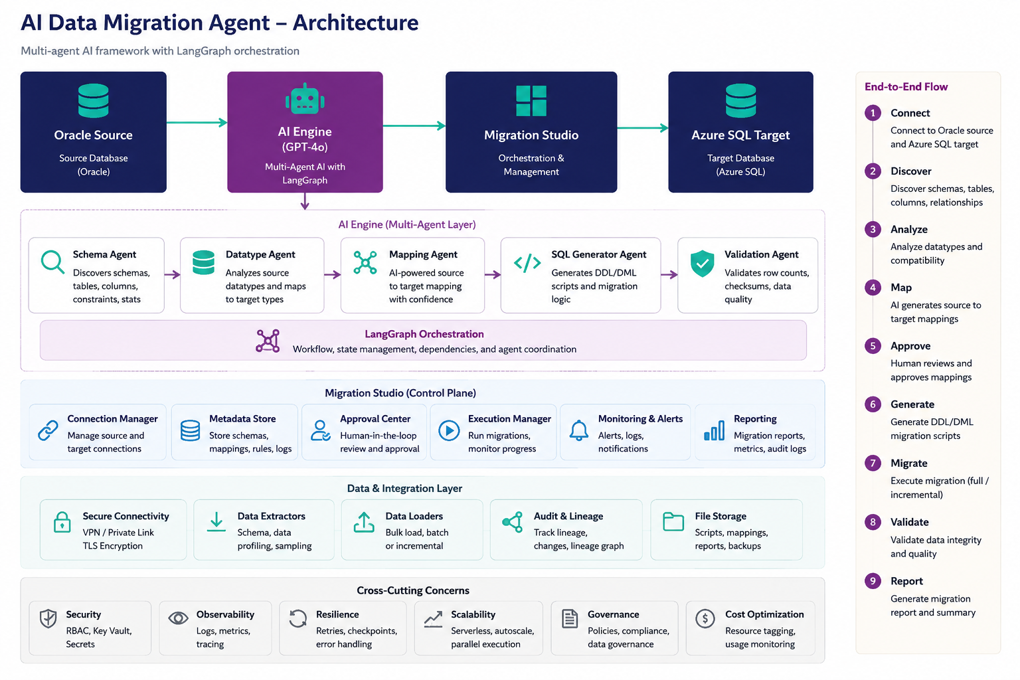
Architecture
AI Data Migration Agent

Slide 6
Benefits
Speed & Efficiency
• 90% faster schema analysis
• 60-80% reduction in manual assessment effort
• Automated DDL — zero hand-coding
• Parallel batch data transfer
• Single workflow replaces 5+ manual tools
Intelligence & Accuracy
• Consistent, traceable AI recommendations
• Risk scoring: Low / Medium / High per column
• Rule-based fallback if AI unavailable
• AI explains every decision in natural language
Quality & Governance
• Human-in-the-loop approval gate
• 6-check validation (rows, NULLs, checksums)
• Full audit trail for compliance
• Zero unintended changes to production
Cost Reduction & Reporting
• Faster discovery-to-readiness (weeks → days)
• Fewer errors — AI catches issues early
• Reusable across Oracle, SQL Server, Snowflake
• AI-generated executive summaries & PDF reports
Row Accuracy - Tables Migrated - Migration Time
99.9% 50+ <2hrs

